Slide 1


Slide 2
Outline
Executive Summary
Introduction
Methodology
Results
Next steps
Appendix

Slide 3
Executive Summary
Summary of Methodologies
Data Wrangling
Zoho bulk import
Reconciliation of Zoho books with tally book prior to handover

Slide 4
Introduction
Project background and context
The client is a Chennai based service provider established in the year of August 2022.
They are currently maintaining books of accounts the most popular and flexible ERP Tally.
They are in process of shifting to Zoho books on seeing it real time analytics and ease of usage.
Problem Statement.
How to migrate from Tally to Zoho books with low turnaround time while maintaining accuracy in migration.

Slide 5
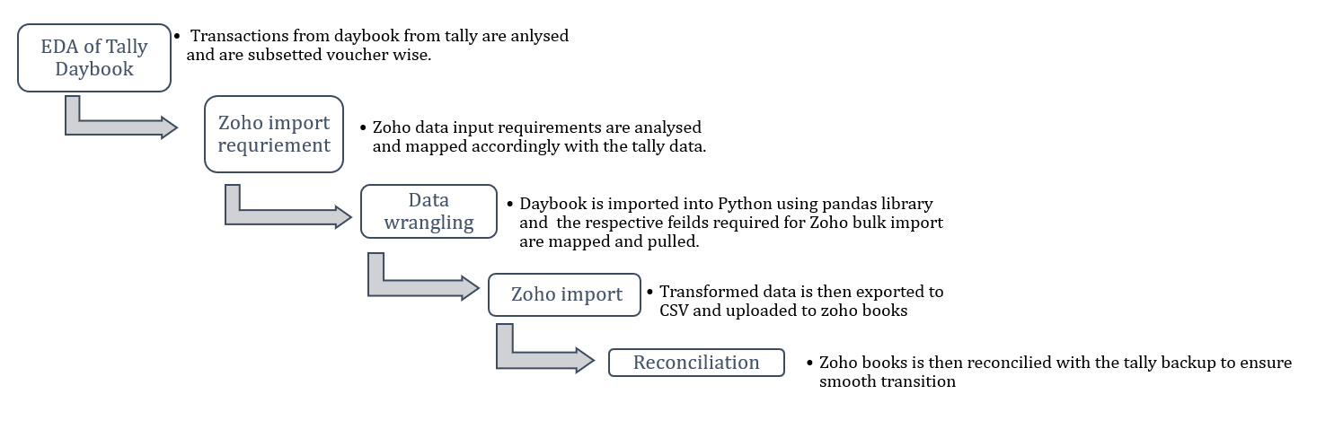
Methodology

Slide 6
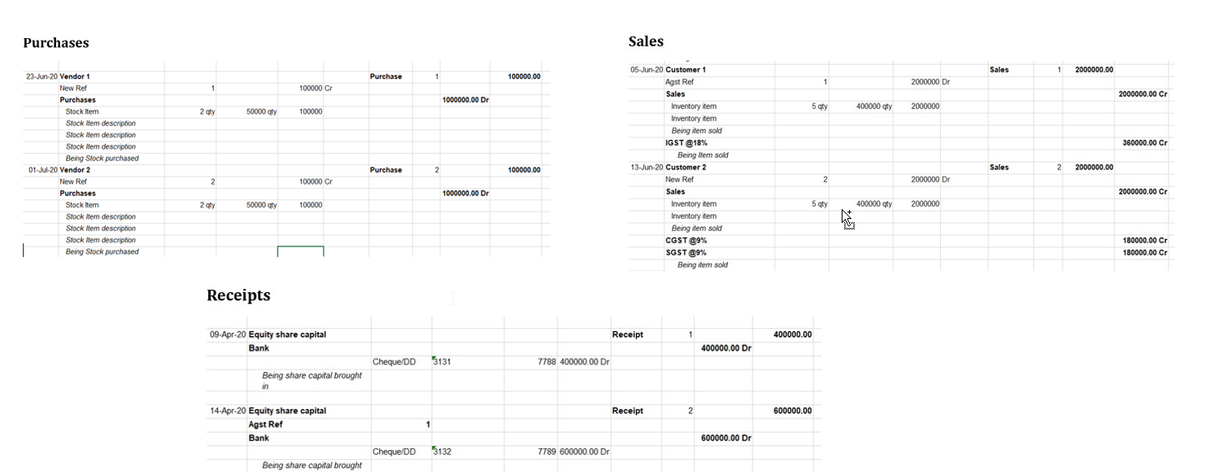
Raw Data Image

Slide 7
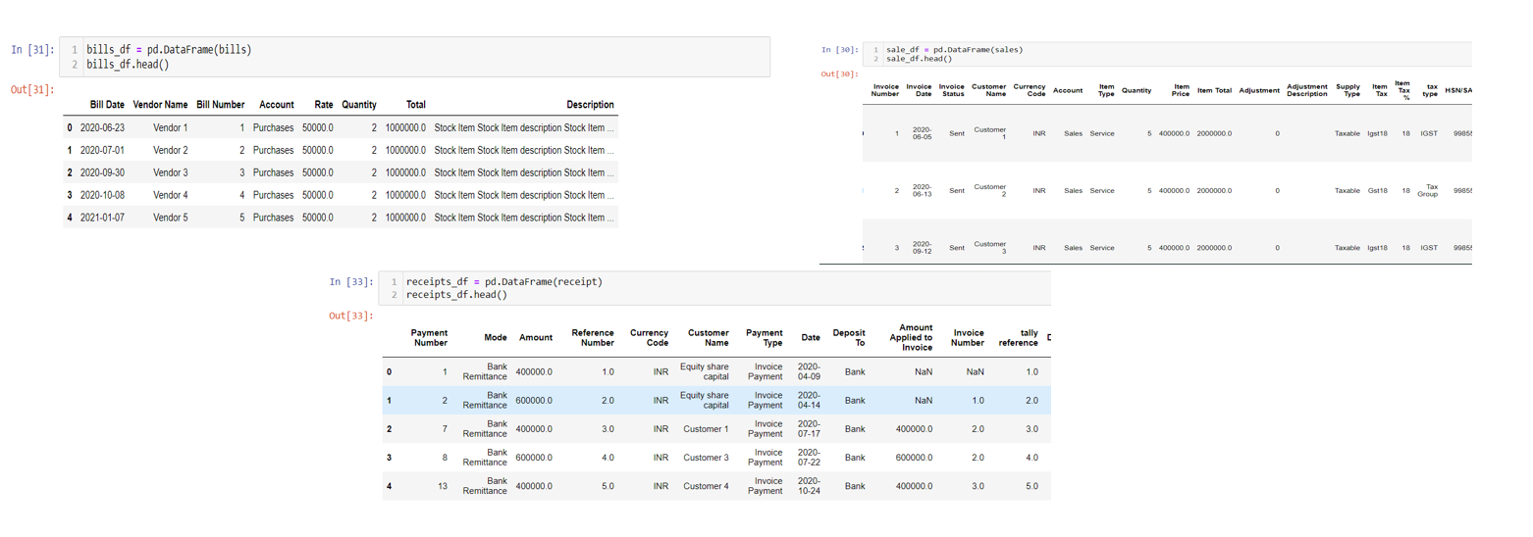
Wrangled Data

Slide 8
Findings
Income by way of Commission not recorded separately.
During the initial EDA it was observed that the income by way of commission is recorded in the books of accounts without giving effect to the respective income account. The entry passed in the tally debits the Receivables account and credits the vendor account.
This practice has 2 effects.
It affects the ledger health as one has to analyse in detail before getting the actual payable of the account.
Income by way of commission is not readily available for the user.
Recording of purchases/payments /bills and receipts in Journal module.
During the EDA stage it was observed that Journal vouchers had transactions which should have been accounted in the respective voucher module.

Slide 9
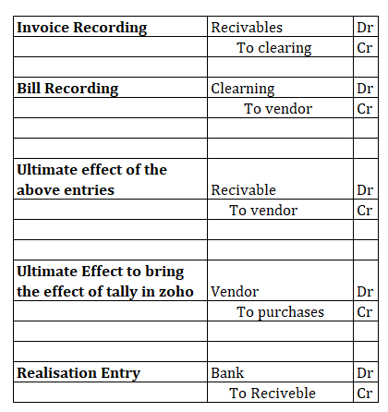
Results
1. Currently we have given effect of the commission as recorded in the tally in manner as picture. However it is suggested to income separately so as to have a better grip on position.
2. Journal Vouchers has be completely sub-set and respective receipt/payment/bills and sales effects have been given effect in the Zoho books.
3. Reconciliation of tally backup to-date with Zoho books is complete and the Zoho books is complete operational as on data.

Slide 10
Next Steps
Zoho Training is to be given to the employees.
Complete internal audit of the books of accounts and the current process is recommended.
Few insights of the sales and expenses can be found in the dashboard link as attached below.
Link : https://fin-dashboard-demo.onrender.com
Please note that the dashboard created is not of Zoho but created in python using DASH framework. However the same can be integrated into Zoho thorough the Zoho’s Deluge.

Slide 11
Thankyou for choosing us
Vignesh Krishnan

